Slide 1


Atliq Hardware

Slide 2
Outline
Atliq Hardware (imaginary company) is one of the leading computer hardware producers in India and well expanded in other countries too.
Nevertheless, the management noticed that they do not have sufficient insights to make prompt, wise and data informed decisions.
Plan to expand their data analytics team by adding junior data analysts.
To assess candidates, Data analytics director, Tony Sharma plans to conduct a SQL challenge to evaluate both tech and soft skills.
The company seeks insights for 10 ad hoc requests.
Tools : Used MySQL for ad hoc requests and Power BI for Level 1 Analysis to gain the better overall insights of all segments.

Slide 3
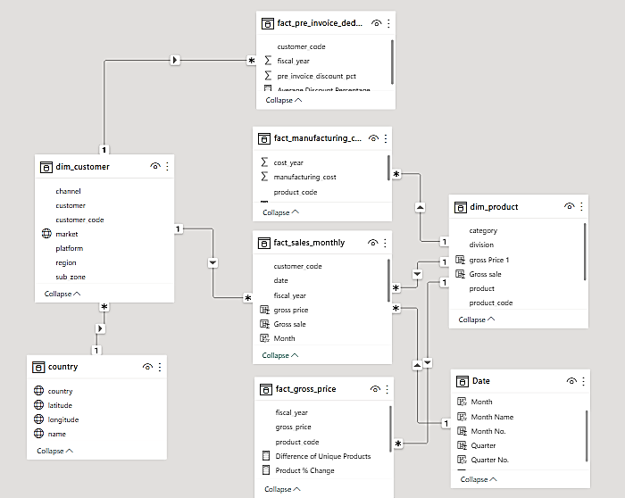
Data Model
Few additional calculated columns and calculative measures are created using DAX in Power BI

Slide 4
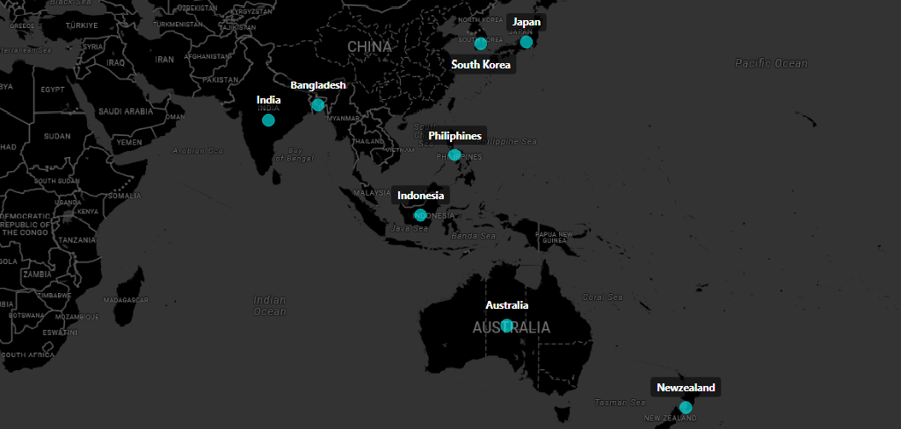
1. Provide the list of markets in which customer "Atliq Exclusive" operates its business in the APAC region.

Slide 5
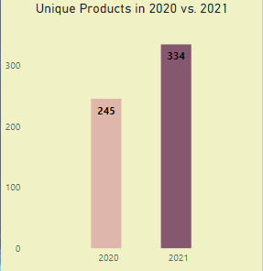

2. What is the percentage of unique product increase in 2021 vs. 2020? The final output contains these fields,
unique_products_2020 unique_products_2021 percentage_chg
Percentage Change 36.33%
Insight:
In 2021 Demand of products have increased

Slide 6
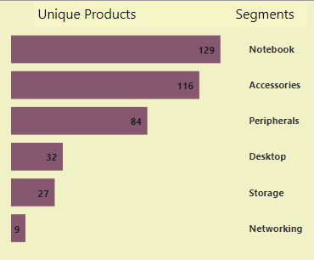
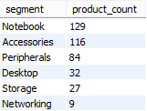
3. Provide a report with all the unique product counts for each segment and sort them in descending order of product counts. The final output contains 2 fields,
segment product_count
Unique Product Count for each Segment
Insight:
Demand of these products are less, Can be the Segments of future Growth

Slide 7
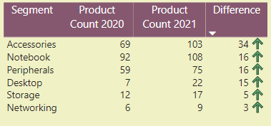
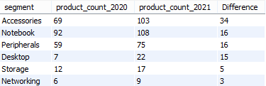
4. Follow-up: Which segment had the most increase in unique products in 2021 vs 2020? The final output contains these fields,
segment product_count_2020 product_count_2021 difference
Unique product difference per Segment from FY2020 to FY2021
Insights :
Accessories had the highest increase in Demand and Supply.
Storage and Networking are experiencing slower growth than other Segments.

Slide 8

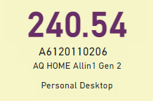
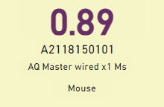
5. Get the products that have the highest and lowest manufacturing costs. The final output should contain these fields,
product_code
product manufacturing_cost
Insights :
Mouse has the lowest manufacturing cost.
Personal Desktop has the highest manufacturing cost.
Product and Category

Slide 9
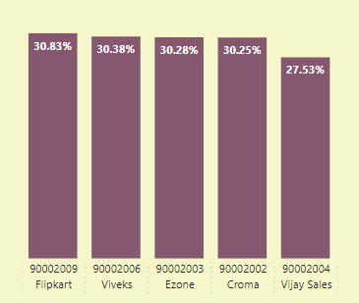
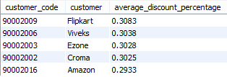
6. Generate a report which contains the top 5 customers who received an average high pre_invoice discount_pct for the fiscal year 2021 and in the Indian market. The final output contains these fields,
customer_code
customer average_discount_percentage
Top 5 Indian Customers with highest average discount % for FY 2021
Insights:
Flipkart got the highest average pre-invoice discount
Amazon got the least average pre-invoice discount
Customer code and Customer

Slide 10
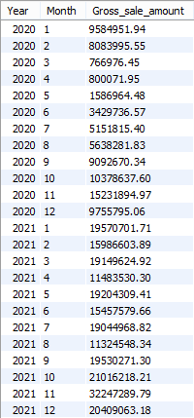
7. Get the complete report of the Gross sales amount for the customer “Atliq Exclusive” for each month. This analysis helps to get an idea of low and high-performing months and take strategic decisions. The final report contains these columns:
Month
Year
Gross sales Amount
FY 2020
79.5 M
FY 2020 : September 2019 – August 2020
FY 2021
224.4 M
FY 2021 : September 2020 – August 2021

Slide 11
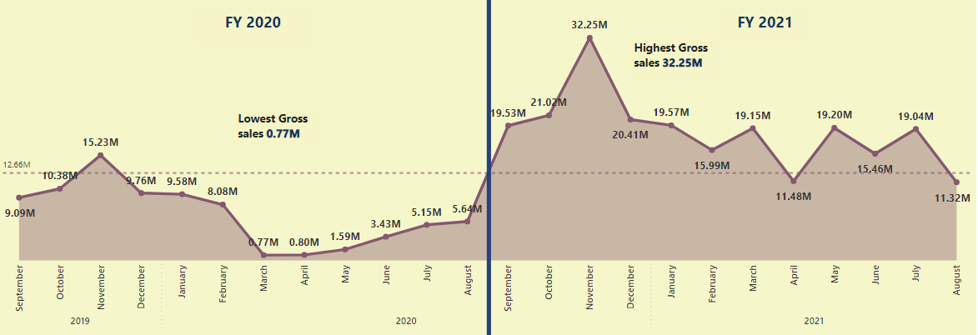
Insights :
Lowest Sale happened in March 2020 and Highest Sale happened in November 2021.
Sale started increasing from the Start of the FY 2021.

Slide 12
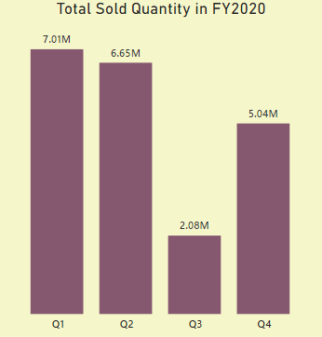

8. In which quarter of 2020, got the maximum total_sold_quantity? The final output contains these fields sorted by the total_sold_quantity,
Quarter total_sold_quantity
Insights :
In Quarter 1 highest products have sold, while in Quarter 3 least products have sold in FY 2020.
Quarter 1 account the 34.4% of the total sold quantity in FY 2020.

Slide 13
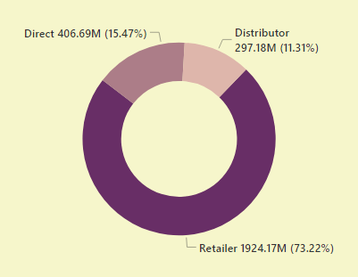

9. Which channel helped to bring more gross sales in the fiscal year 2021 and the percentage of contribution? The final output contains these fields,
channel gross_sales_mln percentage
Contribution % and Gross Sale by Channels in FY 2021
Insight :
Retailers are bringing the Maximum sale while Distributors are bringing the Least sale to the company.

Slide 14
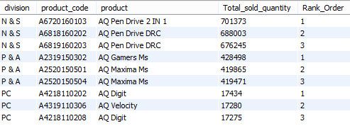
10. Get the Top 3 products in each division that have a high total_sold_quantity in the fiscal_year 2021? The final output contains these fields,
division
product_code
Product
total_sold_quantity
rank_order
Insights :
In Division N&S’s products are selling more than the other Two Divisions.
Same Product with different Product code are appearing more than once in Top 3 products sold.

Slide 15
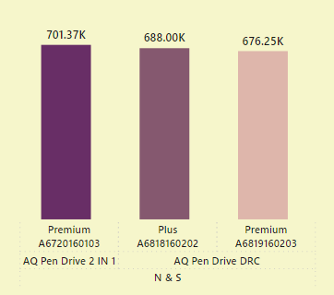
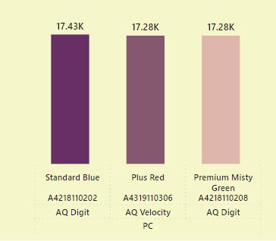
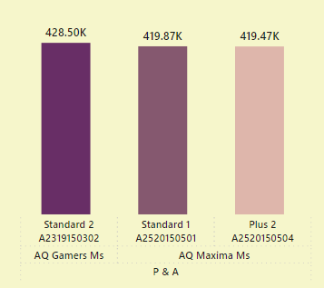
1st
2nd
3rd
1st
2nd
3rd
Division P & A
Division N & S
Division PC
1st
2nd
3rd

